Slide 1
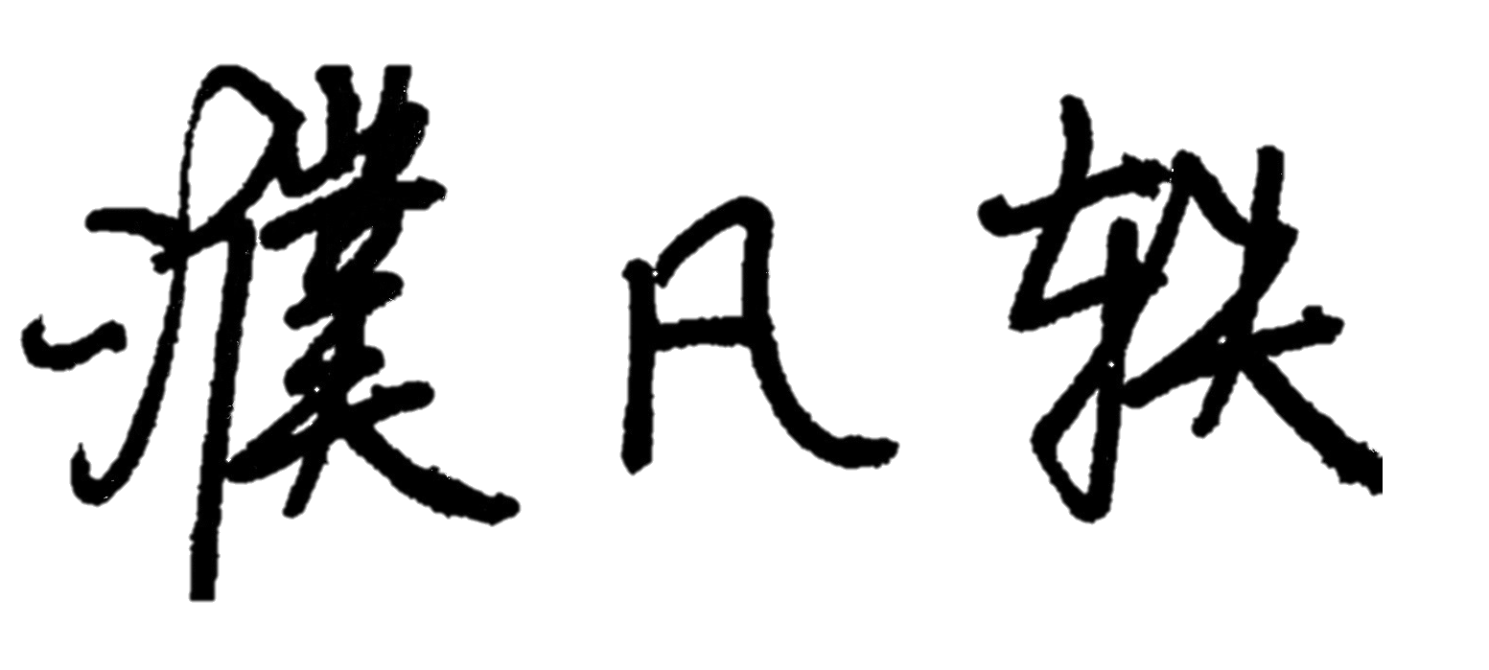




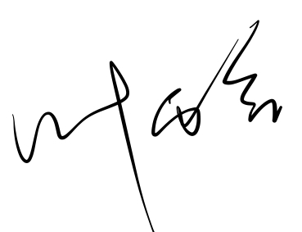
Full Name | Individual Contribution to Lab 1 Submission | Percentage of Contribution | Signature
Pu Fanyi | ER Diagram | 14.29%
Jin Qingyang | ER Diagram | 14.29%
Qian Jianheng Oscar | ER Diagram | 14.29%
Soo Ying Xi | ER Diagram | 14.29%
Ting Ruo Chee | ER Diagram | 14.29%
Ye Yuhan | ER Diagram | 14.29%
Tang Yutong | ER Diagram | 14.29%

